Slide 1
Communications Workshop:
Islands in the [Video] Stream Inside a Digital Content Hub

Slide 2
Welcome!
Three person core team
Relative lean shop
Newsroom Philosophy
Two part session – with time for questions
Notes:
[Adam]
*Introduce Jamie, Todd and myself – with brief backgrounds (media, not textbook PR) *Duties include all external communications & web development
*Lean shop, budgeting for equipment. This can be done with the right tools/people without a huge staff.
*Newsroom philosophy for communications. List divisions. Each issue is independent and we decide what tools to use to promote.
*Session will be divided into two parts, with lots of time for questions. One will be us talking and the other will divide the room into two groups to see how we’ve developed the studio and then see a demonstration on how to use basic equipment if you aren’t familiar with video.

Slide 3
Video Example:
How-To: File an Annual Report – LLC
Created for LLCs, For Profit Corporations, Nonprofit Corporations and LLPs
Notes:
*Business Service is by far our largest customer
*Todd/Adam can discuss process of working with Business Services on all four examples
*Camtasia Studio 8 is screen capture tool used
*Only play a small example
*Script is written before we begin!

Slide 4
Video Example: Why Your Vote Matters
Released September 1, 2015
for the #GoVoteTN campaign and National Voter Registration Month
Notes:
*Unique to Nashville. Worked with country artist Kicks Brooks to provide main voice over because he is passionate about voting.
*Used in-house employee voice over
*Used in-house graphic designer to help with the slides (Todd can elaborate)
*Evergreen for future use across web and social platforms

Slide 5
Video Example: #BinCheck
Released July 1, 2015 for the #BinCheck campaign as part of updates to the Charitable Solicitations Act
Notes:
*Jamie talk about social campaign as part of video launch
*Script written after collecting video/sound

Slide 6
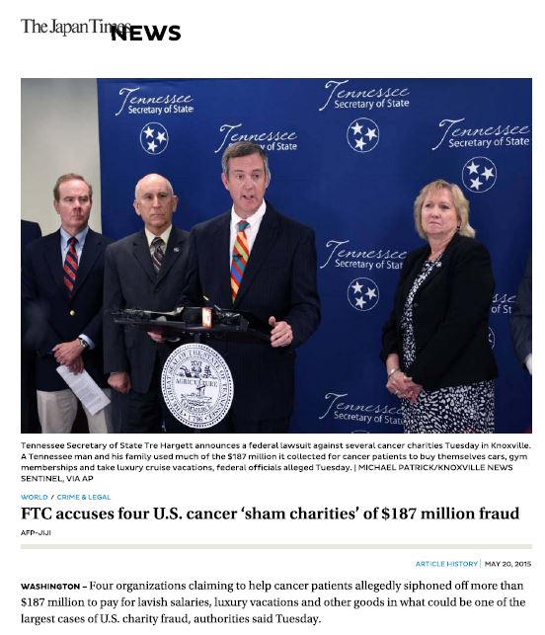
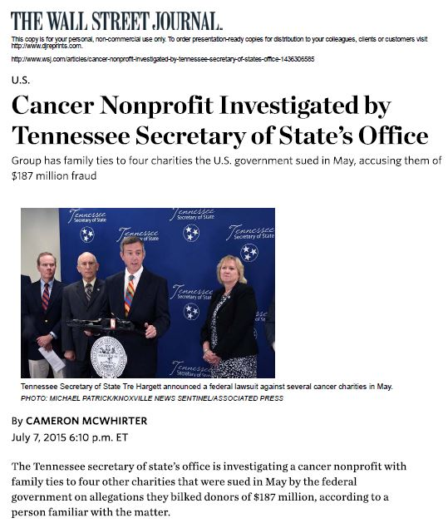
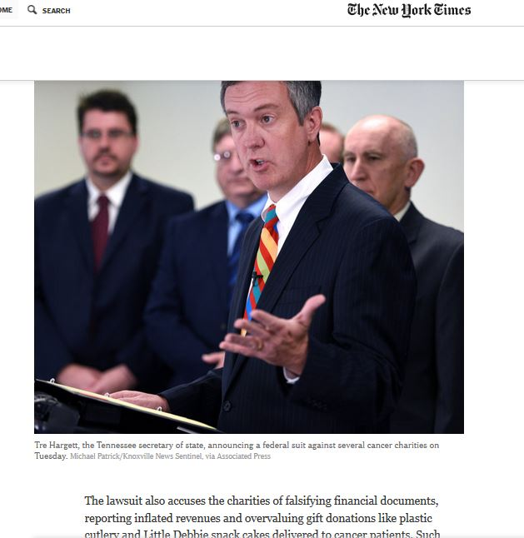
Video Example: Fake Cancer Charities
Original release – May 19, 2015
Follow up release – March 30, 2016
Notes:
--All in one place
--Worked with FTC to coordinate
--Picked up internationally (Wall Street Journal, New York Times, Japan Times)

Slide 7
Video Process
Preproduction-
Plan!
Production-
Gather Your Pieces!
Postproduction-
Put the Pieces Together!
Notes:
Preproduction – Plan, identify, schedule,
Production – Gather your video elements (Gather b-roll, interviews, voiceover,)
Postproduction – Put your pieces together (Editing Software, cover up mistakes, music (shockwave-sound.com for paid, vimeo for free) review process “Unlisted” on youtube and go “Public” once approved

Slide 8
Preproduction
Starts with an Idea
What is the Goal?
Who is the Audience?
What Elements Do We Need?
Anything To Avoid?
Script Writing
Completion Date?
Notes:
Preproduction – Plan, identify, schedule,
Plan example – Access to capitol on the weekends, schedule interviews, creating dummy business information
Avoided example – No people seen in capitol video, no faces in voting video, sensitive information like social security numbers)

Slide 9
Production
Conduct Interviews
Record Voiceover
Bad Audio = Bad Video
Collect B-roll, Photos, Graphics
Notes:
Production – Gather your video elements (Gather b-roll, interviews, voiceover,)
Direct address or interview style
Interviews- say and spell name, title
Race/Gender balance
Audio is important!
Show and tell cameras and mics (pros and cons)

Slide 10
Postproduction
Transfer and Organize
Back It Up
Edit
Upload and Share for Review
Go Public
Notes:
Postproduction – Put your pieces together (Editing Software, cover up mistakes, music (shockwave-sound.com for paid, vimeo for free) review process “Unlisted” on youtube and go “Public” once approved. Sometime people don’t know what they want until they see what they don’
Where should it live on the website? What else can you do? Capitol video event and dvd distribution to schools and libraries across the state. Adobe Premiere subscription for $20 monthly, Premiere Elements is $99, Final Cut X (Mac) $299.

Slide 11
Check out our YouTube channel for more examples.
Sec. Tre Hargett
Notes:
*Quickly show YouTube channel
*Todd talk about different video categories / levels of production (How-To versus news conference versus documentary style)

Slide 12
Tutorials
Notes:
Tutorials – Lynda.com – high quality, on demand how to videos, easily searchable – Click on image (hyperlink to site)

Slide 13
Video Distribution - Media
Six major media markets able reach more than 6.6 million Tennesseans (plus people in eight other states)
Cannot be Nashville centric
Recorded interviews and press conferences, sent to other markets via OwnCloud (similar to DropBox)
It’s all about relationships!
Notes:
--Chattanooga example
--Media tour

Slide 14
Social Media Tools

Slide 15
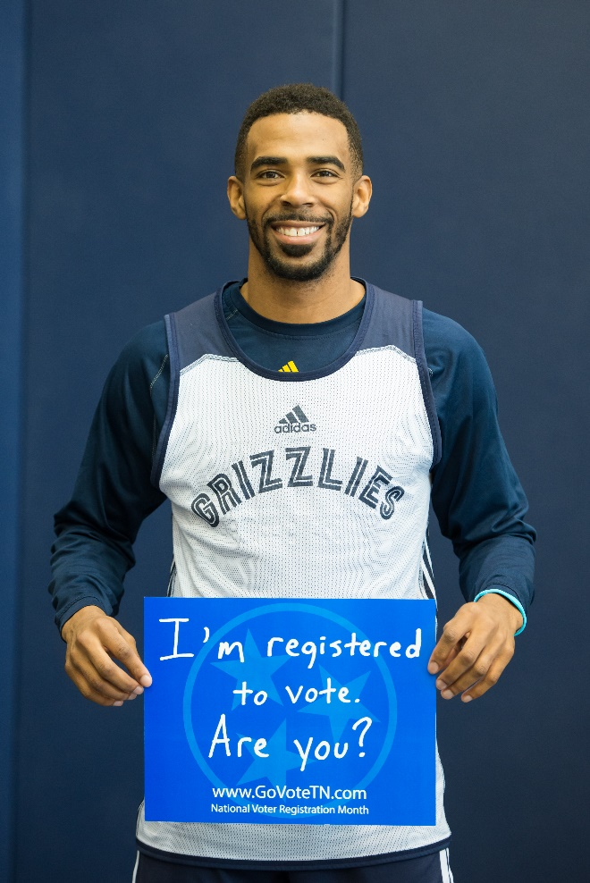
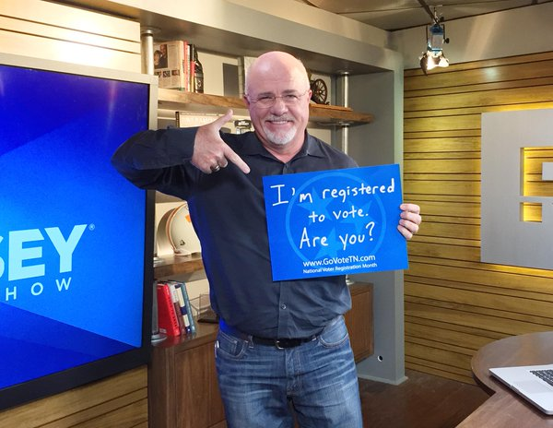
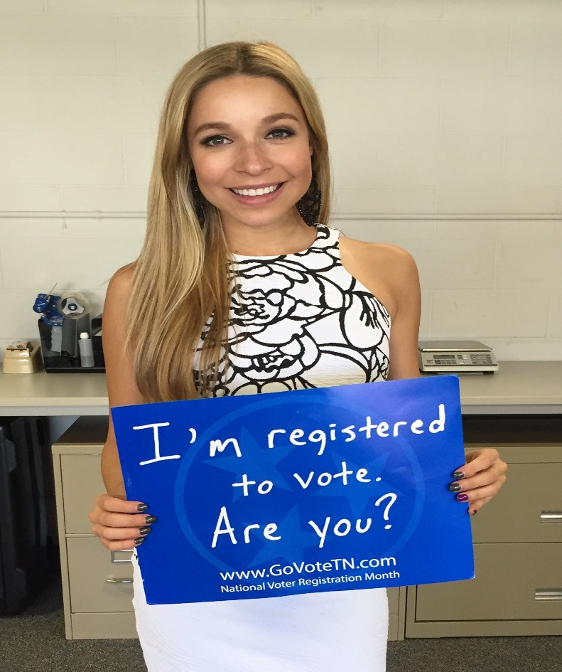
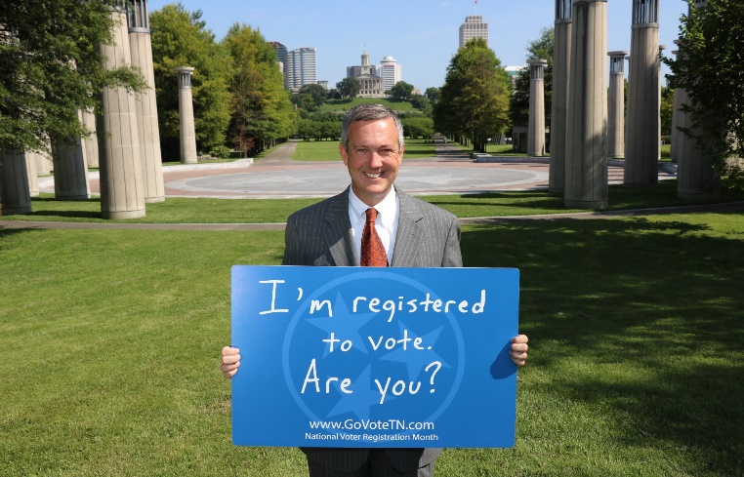
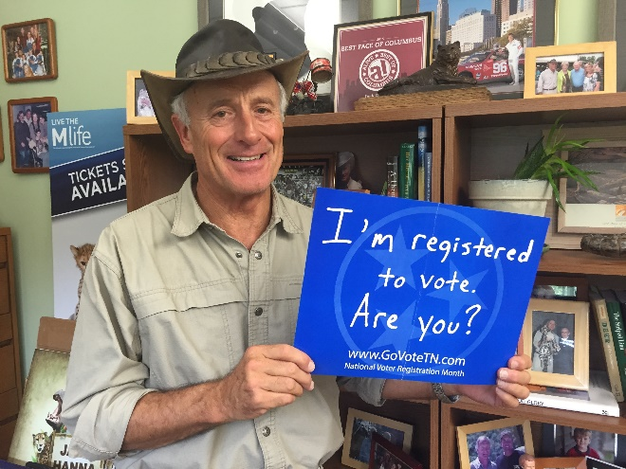
#GoVoteTN
Voter Registration
Celebrities that have a state or national presence.
All must be registered to vote
Encouraging citizens to take part.
Notes:
*Picture Releases.

Slide 16
@SecTreHargett
TennesseeSecretaryofState
@sectrehargett
#GoVoteTN
Create – Proof – Post – Analytics
Notes:
Workflow
Create – Proof – Post – Analytics
Wireless Camera – Went from Bad photo’s to really good high quality in seconds.
Approval = Trust
Social Media Policy
Change it up, Twitter ½ life = 18 vs. 2 Hours and Facebook up to 36 hours from last like.
Tagging
Election Night – Direct Media + 15 Twitter accounts tailored to races.

Slide 17
What’s on the horizon?
Facebook live for news conferences
New animation software to help with nonvisual topics: GoAnimate.com
New camera to replace DSLR with a true video camera capable of producing 4K video to “future proof” equipment
Streaming for live interviews from studio

Slide 18
Split into two groups!

Slide 19
Questions?

